Slide 1
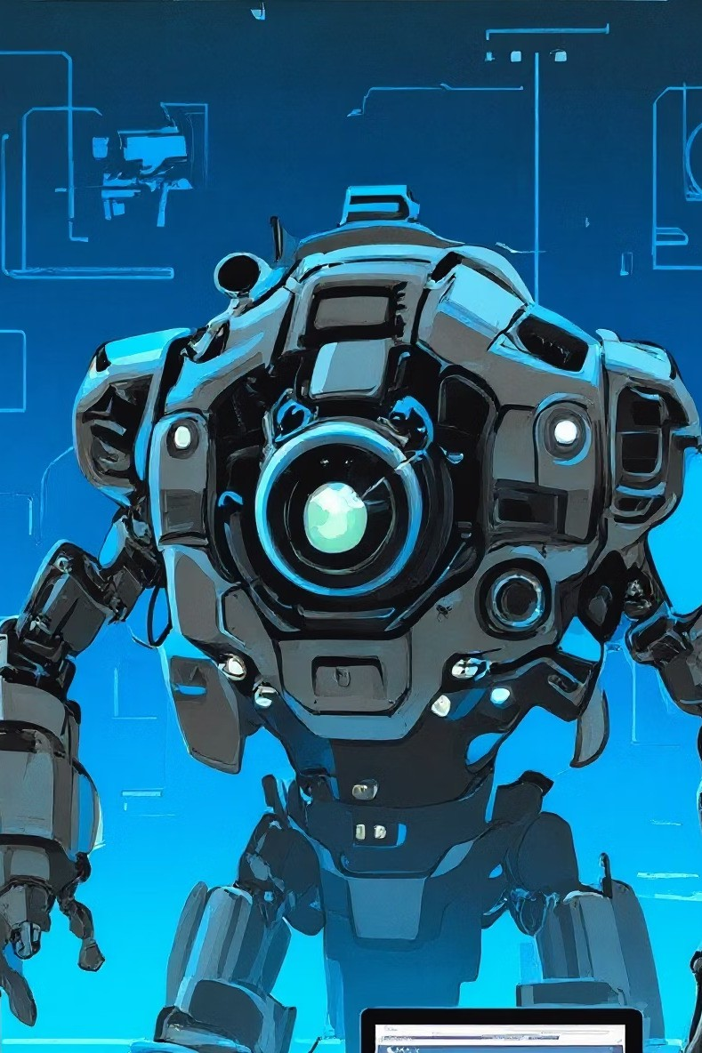

ElectroPro: Empowering Tomorrow's Innovators
Founded in 2016, ElectroPro is an MSME registered technology company at the forefront of robotics, embedded systems, IoT, AI, and automation. We are committed to fostering technological literacy and innovation, operating across India and with a growing international presence in Australia, Ghana, and Togo. Our mission is to equip the next generation with the skills and mindset needed to lead in a rapidly evolving world.

Slide 2


Our Vision & Mission
Education Through Innovation
We believe in developing society through innovative education, guiding students toward responsible citizenship and better career planning in a tech-driven future.
PROLAB Initiative
Creating hands-on learning opportunities for all Indian children to become world leaders in technology through practical experience and exploration.

Slide 3
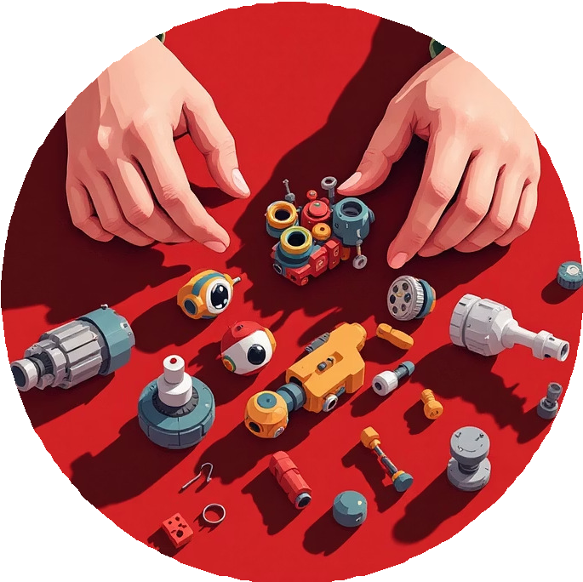


Why Teach Robotics in School?
Robotics education is a global phenomenon that transforms learning. It goes beyond technical skills, cultivating crucial 21st- century competencies like creative thinking, problem-solving, and collaboration, which are vital for future success and innovation.
Creative Thinking
Nurtures curious minds by challenging students to build machines that mirror human capabilities.
Enhanced Engagement
Hands-on activities maintain focus and motivate students to participate actively in their learning.
Tech Preparedness
Immerses students in cutting-edge fields like AI, drones, and autonomous vehicles.

Slide 4




Developing Essential Future Skills
Robotics education builds a suite of skills critical for academic and professional success. From logical thinking to resilience, students gain invaluable experience through interactive and fun learning.
Programming Skills
Develops the logical thinking essential for creating and interacting with AI-powered devices.
Perseverance
Builds a "never give up" attitude through trial-and-error challenges inherent in scientific discovery.
Teamwork Culture
Promotes collaborative learning where diverse skills are combined to solve complex problems.

Slide 5




Level f: Young Scientist Program
Designed for Grades 4-10, this program includes 16 sessions to build foundational knowledge in robotics and electronics. Students embark on their first engineering journey, guided by expert techno-professionals.
Sensor Exploration
Engage in hands-on projects like automatic streetlights and human detection systems.
Foundation Building
Create your first robot, learn basic electronics, and get practical soldering experience.
Assessment
A final test validates skills, followed by certificate distribution from company experts.
Motor Mastery
Test various motors and learn to assemble and disassemble 2-wheeler robots.

Slide 6

Level 2: Junior Engineer Program
This program delves deeper into robotics and programming over 17 intensive sessions. It focuses on hands-on application and prepares students for complex challenges using Arduino and advanced sensors.
0!
Arduino Basics
Learn programming fundamentals with LED testing and traffic light projects.
02
Advanced Sensors
Integrate IR, LDR, PIR, and thermistor sensors with Arduino programming.
03
Robot Projects
Build obstacle avoidance, light follower, and fire-finding robots.
0h
Wireless Control
Get an introduction to controlling robots via smartphone, followed by final certification.

Slide 7



Internet of Things (IoT) Program
Spanning 50 hours for Grades 7-10, our IoT Program explores how physical devices connect to the internet for smart communication. Students receive a dedicated kit to facilitate practical learning with the ESP-32 microcontroller.
Foundations
Explore IoT basics, real-world applications, and essential electronics.
Programming
Learn core coding fundamentals and get introduced to the ESP-32.
Cloud & App
Understand cloud platforms and develop mobile apps using Blynk.
Projects
Undertake 10 hands-on projects, from LED control to Google Home automation.

Slide 8

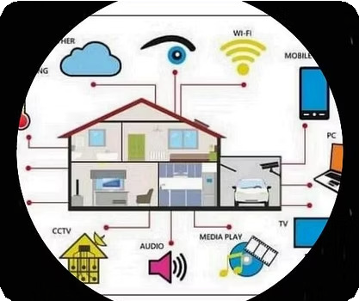
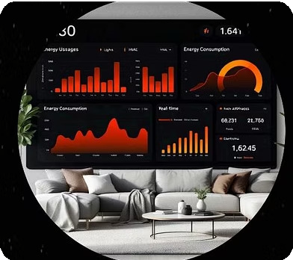

IoT Applications Across Industries
The Internet of Things is revolutionizing diverse sectors by integrating smart technology into everyday processes, offering unparalleled efficiency and insight. Discover how IoT is transforming industries globally.

Slide 9
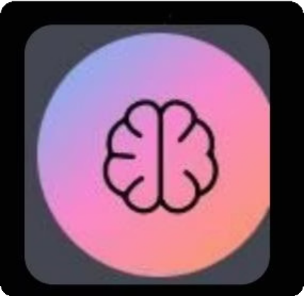
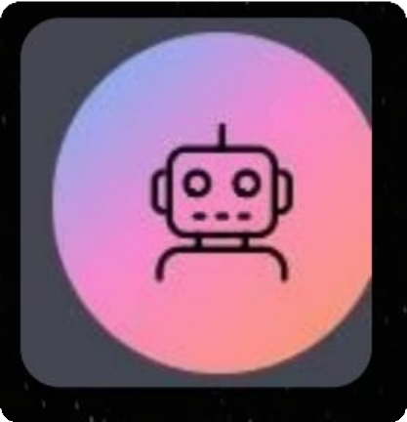
Artificial Intelligence (AI) Program
Our AI Program introduces students to the world where computers think, learn, and perform human-like tasks. This program covers data analysis, machine learning, and neural networks using Python.
Core Concepts
Introduction to AI, data analysis, machine learning, and neural network fundamentals.
Programming
Learn Python, data visualization, and hands-on AI project development.
Advanced Applications
Explore natural language processing and computer vision for real-world solutions.

Slide 10
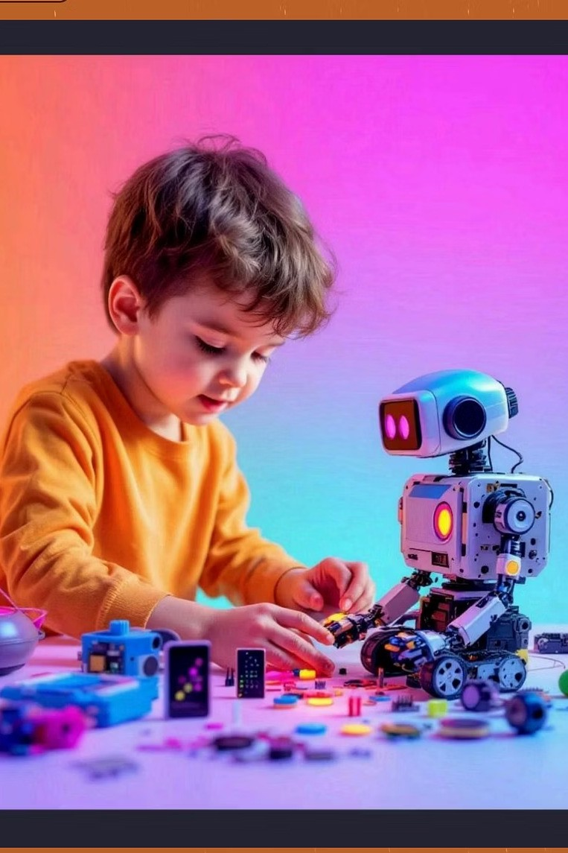
Embrace Innovation Today!
Invest in a future of creativity and problem-solving. Instead of a smartphone, gift your child a robotic kit and spark a lifelong passion for innovation.
Buy Kits
Visit Website
Share Electropro Share Technology
http://www.electropro.in/
Contact: electroproindia@gmail.com

